Slide 1
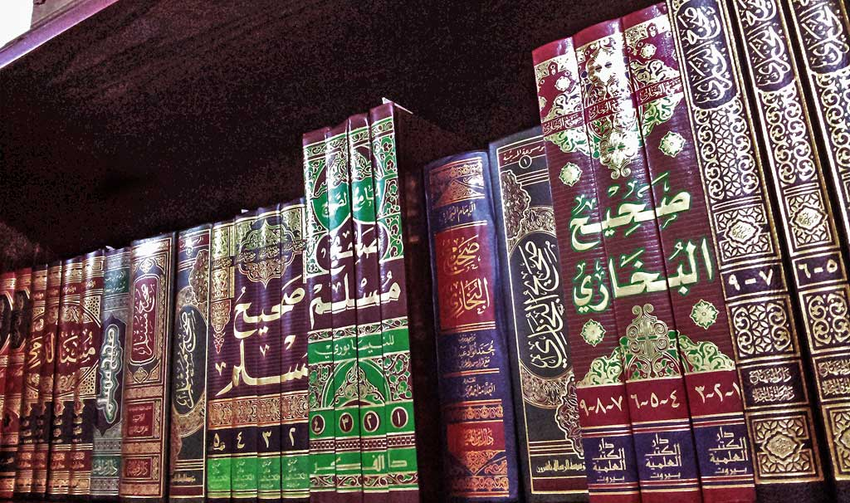
Introduction to Hadith

Slide 2
Points of Lecture
Meanings of Sunnah and Hadith
The definitions of both
Status of a Prophet (Tashri’ee Status)
Obedience of Prophet
Sunnah as interpretation of Qur’an ( with examples)
Authenticity of Hadith
Compilation of Hadith
Major compilation of Hadith ( Ten books minimum)

Slide 3
What is Hadith?
Primary Source of Law
Literally: News, report or narration
Islamic terminology: Sayings, actions and tacit approval of Prophet for any action

Slide 4
Meaning of Sunnah
The literal meaning of Sunnah is the trodden path
The meaning of Sunnah in Islam is الطریقۃ المسلوکۃ فی الدین
“The trodden path of Islam”

Slide 5
HOW IS HADITH USED IN ESTABLISHMENT OF ISLAMIC LAW
Second Source of Law
“O you who believe Obey Allah 1 And obey the Messenger 2 And those charged with authority among you 3 If you differ in anything among yourselves Refer it to Allah and His Messenger” 4 (Al -Nisa 4.59)
Explains where Quran is silent
The Quran repeatedly asks us: “Establish regular prayer” without speaking about the number of raakats and manners in which it should be performed.
Hadith of the Prophet explains it. The Holy Prophet said, “The Messenger of Allah did not leave offering four rakats before the noon prayer.” [Bukhari]
. The Quran enjoins us: “Pilgrimage thereto is a duty men owe to Allah, those who can afford the journey”
Full method of the Hajj is not mentioned in Quran. Sunnah of Prophet explains its performance, as it is said. Ibn Umar reported, “The Holy Prophet pronounced Talbiyah in Hajj and Umrah” Sunnah of the Prophet becomes basis of Ijma and Qiyas. It is a fact that the Prophet not only taught but also took the opportunity of putting his teachings into practice in all the important affairs of life.

Slide 6
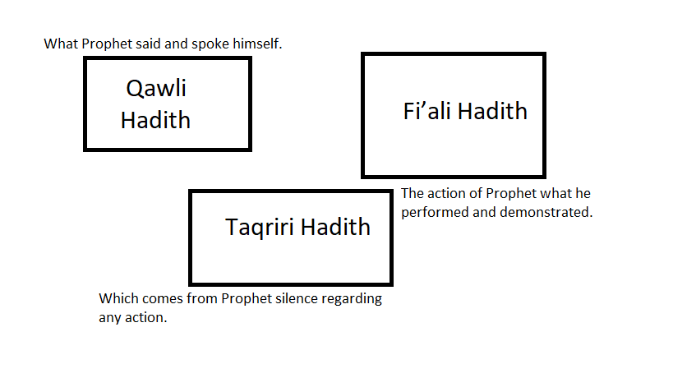
TYPES OF AHADIS:
Hadith Nabawi: which contains the words that Hazrat Muhammad, spoke himself.
For example Holy Prophet said, “All actions are judged by intentions” 2-
Hadith Qudsi : which contains the words from Allah.
For example, when Allah completed creation, He wrote in His book which is with Him above the throne. “Truly My mercy overcomes My wrath”
Hadith e Nabwi further catagorised :

Slide 7
Type of Hadith
1-Qawli Hadith –
what Prophet said and spoke himself.
2- Fi’ali Hadith-
The action of Prophet what he performed and demonstrated.
3- Taqriri Hadith-
which comes from Prophet silence regarding any action.

Slide 8
Hadith has two components:
Matn
The text of the hadith whose meaning is desired.
Speech which has been carried by the particular sanad.
Isnad
path of the narration/chain of the authorities
Recollection of how the narration traveled

Slide 9
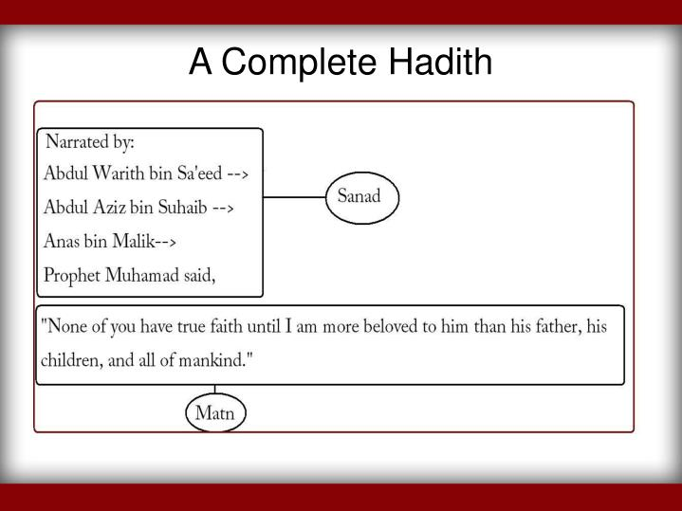

Slide 10
Sanad
Precaution taken in compilation
Matan

Slide 11
Precautions taken in Sanad
Must be un-interrupt
Must not be broken
Must go back to Holy Prophet(s.a.w)
Narrators should have actually met each other
Narrators must not be liars
Narrators should have sharp memory
Narrators must be pious and possess good character

Slide 12
Precautions taken in Matan
Must be in a pure arabic style
Must not be in contradiction to historical facts and common sense
Must not be against Islam , Quran or any other authentic hadith
Must not abuse the family of Holy Prophet(s.a.w)

Slide 13
Division of Hadith on the basis of Sanad
Marfu’a
Mawqoof
sanad stretches back to the Prophet
Maqtoo’a
sanad reches to the companion of Prophet
student of the companion of the Prophet Tabi’ is the end of the sanad
1
2
3

Slide 14
Classification of Hadis
Sahih
transmitted through an unbroken chain of narrators all of whom are of sound character and memory.
Hasan
transmitted through an unbroken chain of narrators all of whom are of sound character but weak memory.
Dha’if
which cannot gain the status of Hasan because it lacks one or more elements of a Hasan hadīth. (For example, if the narrator is not of sound memory and sound character, or if there is a hidden fault in the narrative or if the chain of narrators is broken).
Mawdu
fabricated and wrongly ascribed to the blessed Prophet

Slide 15
Compilation Preservation of Hadith
Memorization
The Arabs were renowned for their memories, particularly their ability to memorize long poems along with the biographies of their authors. Not only that, the Arabs also memorized the lineage of their horses, even the horse’s gaits.
Practice
Because of their deep love for the Blessed Prophet, the prophet’s companions preserved every aspect of the Blessed Prophet’s life; his way of worship, the way he ate, slept, worked, etc.
blessed Anas(r.a) relates, “I saw the Blessed Prophet searching for pieces of squash in a bowl of curry. From that day on, I loved squash.”

Slide 16
Compilation Preservation of Hadith
Documentation
Compiled during the lifetime of the Blessed Prophet.
For example, there is the al-sahifat-ul-sadiqa by hazrat abdullah ibn amar. He himself said: “I wrote whatever I heard from the Blessed Prophet and memorized it. Some members of Quraish discouraged me from recording. They said, “Do you write whatever you hear from the Prophet? He is a man; sometimes he jokes and sometimes he gets angry like any other person.” The Blessed Prophet pointed to his lips and said, “I swear in the name of Allah, in whose hands is my life, that nothing but truth comes from these two lips( sunane abu dawood).”

Slide 17
Compilation Preservation of Hadith
(i) The age of the Prophet and his Companions
Saheefa-e-Sadiqah was compiled by Hazrat Abdullah s/o Amr. Sahifah-i-Abu Hurairah was compiled by a student of Abu Harairah named Humam s/o Munabbah.
(ii) The age of Companion’s students known as Tabien (from 111 A.H. upto 170 A.H.):
During the reign of Hazrat Umer s/o Abdul Aziz as Caliph, he sent a circular in all the cities of Muslim Empire requesting theologians to collect and compile Ahadith from wherever they could find them. In compliance with the directions of Caliph Omer s/o Abdul Aziz, theologians became active to collect and preserve Ahadith.
(iii)The age of students of Tabieen (students of companions) Known as ‘Tabaa Tabieen (from 171 A.H. upto 220 A.H.): The third century of Hijrah calendar is known as the age of Tabaa Tabieen.
Muslim Scholars went to every nook and cranny of the Muslim world to collect Ahadith and other relevant information related to the subject.

Slide 18
Few Compilations of Hadith
Sahih Bukhari (Muhammad b Ismail Bukhari)
Sahih Muslim (Muslim ibn-e-Hajjaj)
Sunan Abu Dawood (Abu Dawood Sulaiman b Asha’s)
Sunan Tirmizi (Abu Isa Muhammad Tirmizi)
Sunan Ibn-e-Maja (Abū ʻAbdillāh Muḥammad ibn Yazīd Ibn Mājah)
Sunan Nasai (Abū `Abd ar-Raḥmān Aḥmad Nasai)
Musnad Imam Ahmad bin Hanbal (Ahmad ibn Hanbal)
Rayyaz uz al salheen (sharaf al mori)
Mishkat ul masabeeh (Muhammad ibn Abdullah)
Tahwi sheef ( Jafar Ahmad )

Slide 19
How is Hadith used in establishment of Ijma?
Ijma; “agreeing upon” or “uniting in opinion”
the Holy Prophet said, “Gather together the righteous from among my community and decide the matter by their counsel…” and Holy Prophet said, “My community will never agree upon an error”.
Decision of Prophet based on Ijma is, At the time of Uhd encounter, Holy Prophet decided to leave the town to meet the enemy rather than to stay at Madinah because the opted decision was the unanimous decision of his companions.

Slide 20
How is Hadith used in establishment of Qiyas?
Qiyas is comparison to establish equality or similarity between two things.
Asl: the fundamental teaching Far: the new matter in question Illah: the linking cause that connects them Hukm: new judgment
Once a woman came to the Prophet and stated that her mother (in some traditions her sister), who had solemnly declared to perform Hajj, had died before doing so. She asked if it was necessary to perform Hajj on her mother’s behalf. The Prophet paused for a while & then said, “Verily what would you do if she had left debts repayable. Naturally you would pay.” Here the ‘Illa’ or effective cause in both cases is the fulfillment of obligations.

Slide 21
CONCLUSION
Hadith have been called "the backbone" of Islamic civilization, and within that religion the authority of hadith as a source for religious law and moral guidance ranks second only to that of the Quran (which Muslims hold to be the word of God revealed to his messenger Muhammad).

